Slide 1
MLSA FULL STACK INTERNSHIP
NAME : UDITA SINGH
ROLL NO. : 2300290120262
BRANCH : CS
YEAR : 2nd

Slide 2
PROJECT – 1 A SIMPLE PERSONAL WEBPAGE (EASY)
The purpose of the personal webpage is showcasing my background, skills, and contact information .

Slide 3
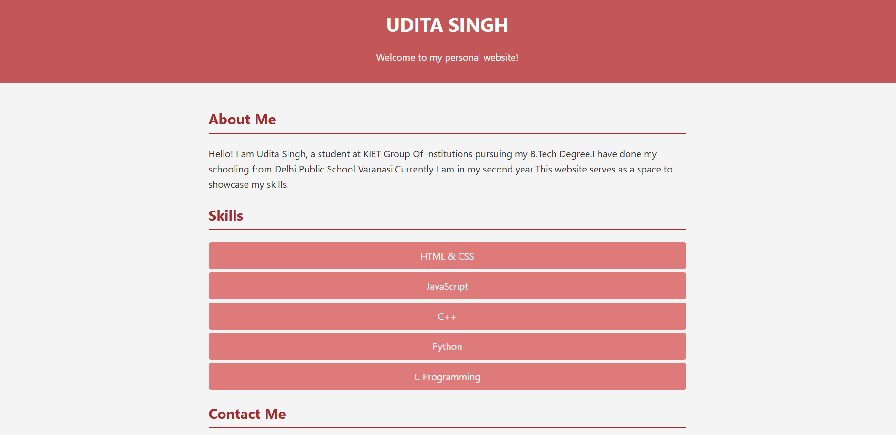

Slide 4
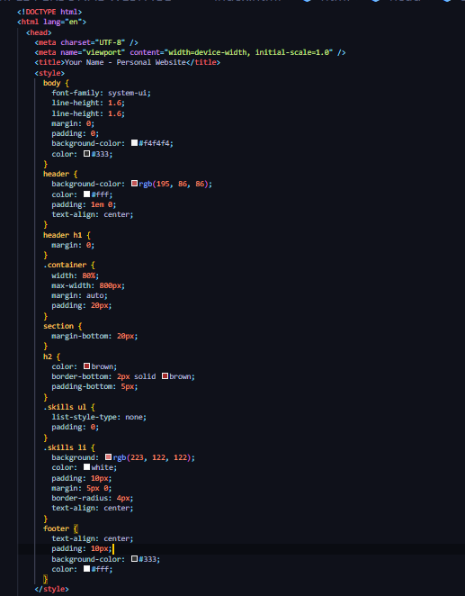
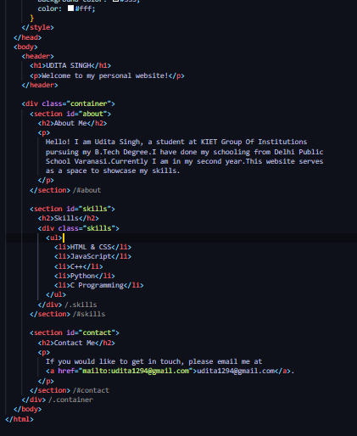
TECHNOLOGY USED : HTML CSS

Slide 5
PROJECT-2 A SIMPLE CALCULATOR (INTERMEDIATE)
A calculator is an electronic or software tool that performs mathematical calculations quickly and accurately. It is designed to handle a variety of mathematical operations, from basic arithmetic to more complex functions, depending on its capabilities. For a simple calculator, the primary functions include:
Addition : Combining two numbers to get their total.
Subtraction : Calculating the difference between two numbers.
Multiplication : Finding the product when a number is multiplied by another.
Division : Determining how many times one number is contained within another.

Slide 6
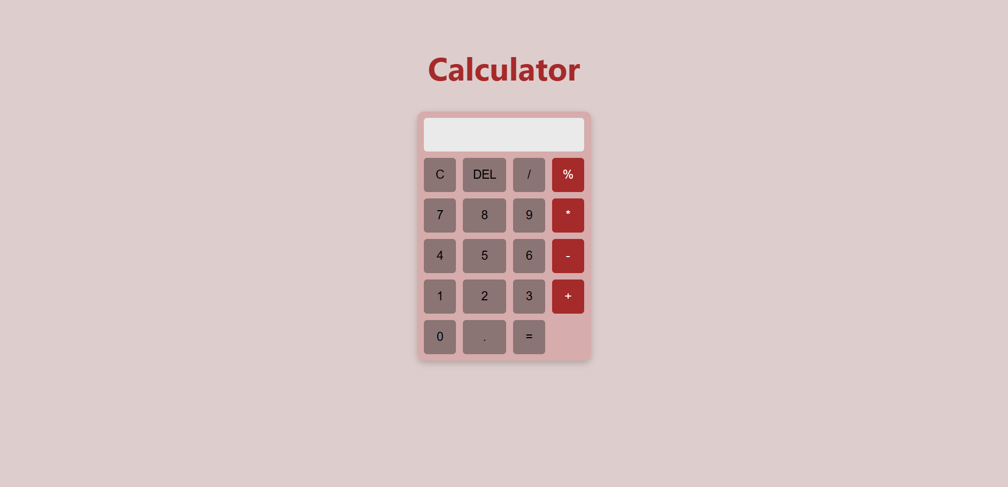

Slide 7
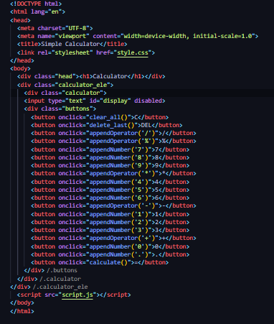
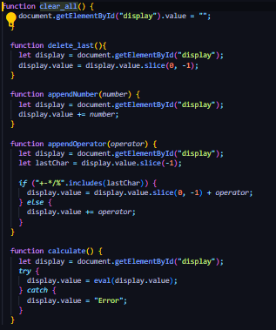
TECHNOLOGY USED : HTML CSS JAVASCRIPT

Slide 8
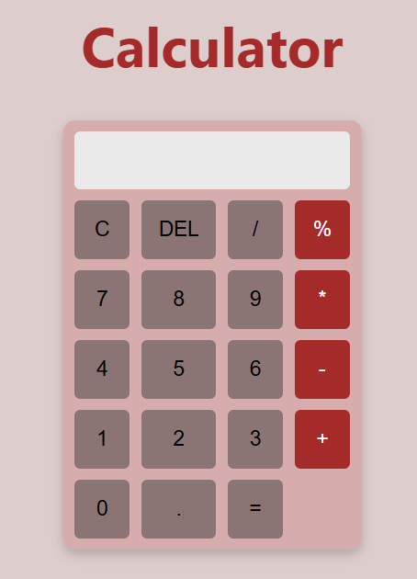
FEATURES: The calculator supports : Addition Subtraction Multiplication Division Modulus Operation Clear Display (C) Delete Last Entry (DEL) Decimal Point Input

Slide 9
THANK YOU

